Slide 1
Chapter 2
Introduction to the C Language
Objectives
❏ To understand the structure of a C-language program.
❏ To write your first C program.
❏ To introduce the include preprocessor command.
❏ To be able to create good identifiers for objects in a program.
❏ To be able to list, describe, and use the C basic data types.
❏ To be able to create and use variables and constants.
❏ To understand input and output concepts.
❏ To be able to use simple input and output statements.
❏ To understand the software engineering role.

Slide 2
2-1 Background
C is a structured programming language. It is considered a high-level language because it allows the programmer to concentrate on the problem at hand and not worry about the machine that the program will be using. While many languages claim to be machine independent, C is one of the closest to achieving that goal. That is another reason why it is used by software developers whose applications have to run on many different hardware platforms.

Slide 3
FIGURE 2-1 Taxonomy of the C Language

Slide 4
2-2 C Programs
It's time to write your first C program! This section will take you through all the basic parts of a C program so that you will be able to write it.
Topics discussed in this section:
Structure of a C Program
Your First C Program
Comments
The Greeting Program

Slide 5
FIGURE 2-2 Structure of a C Program

Slide 6
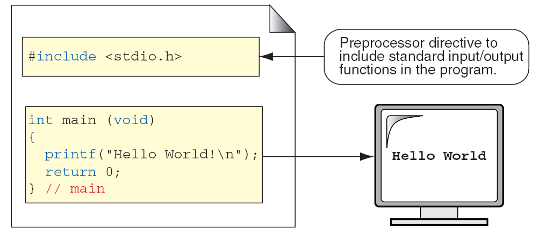
FIGURE 2-3 The Greeting Program

Slide 7
FIGURE 2-4 Examples of Block Comments

Slide 8
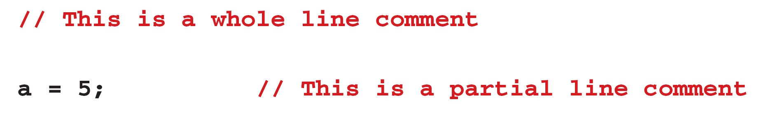
FIGURE 2-5 Examples of Line Comments

Slide 9
/* ====== /* ------ */ ====== */
FIGURE 2-6 Nested Block Comments Are Invalid

Slide 10
PROGRAM 2-1
The Greeting Program

Slide 11
2-3 Identifiers
One feature present in all computer languages is the identifier. Identifiers allow us to name data and other objects in the program. Each identified object in the computer is stored at a unique address. If we didn’t have identifiers that we could use to symbolically represent data locations, we would have to know and use object’s addresses. Instead, we simply give data identifiers and let the compiler keep track of where they are physically located.

Slide 12
Table 2-1
Rules for Identifiers

Slide 13
Note
An identifier must start with a letter or underscore: it may not have a space or a hyphen.

Slide 14
Note
C is a case-sensitive language.

Slide 15
Table 2-2
Examples of Valid and Invalid Names

Slide 16
2-4 Types
A type defines a set of values and a set of operations that can be applied on those values. For example, a light switch can be compared to a computer type. It has a set of two values, on and off. Only two operations can be applied to a light switch: turn-on and turn-off.
Topics discussed in this section:
Void Type
Integral Type
Floating-Point Types

Slide 17
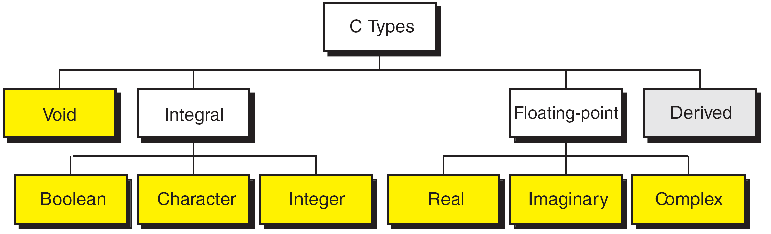
FIGURE 2-7 Data Types

Slide 18
Void
Indicates no values and no operations
Useful for functions and pointers
Keyword: void
Boolean
Either true (1) or false (0)
New addition in C99
Keyword: bool

Slide 19
FIGURE 2-8 Character Types

Slide 20
FIGURE 2-9 Integer Types

Slide 21
Note
sizeof (short) ≤ sizeof (int) ≤ sizeof (long) ≤ sizeof (long long)

Slide 22
Table 2-3
Typical Integer Sizes and Values for Signed Integers

Slide 23
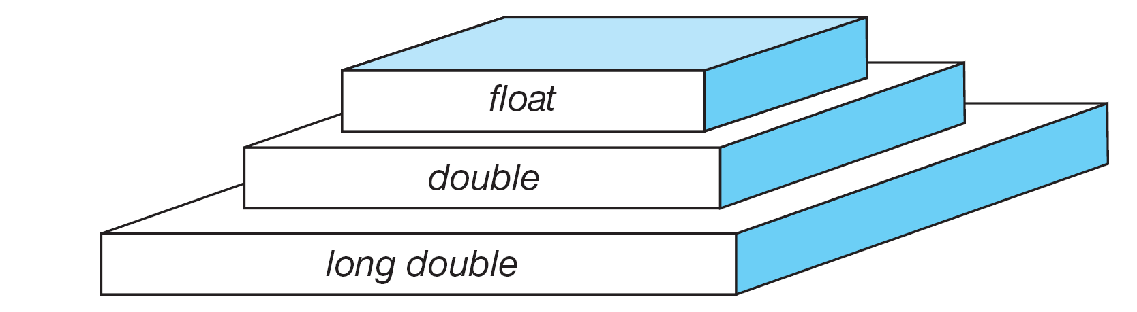
FIGURE 2-10 Floating-point Types

Slide 24
Note
sizeof (float) ≤ sizeof (double) ≤ sizeof (long double)

Slide 25
Table 2-4
Type Summary

Slide 26
2-5 Variables
Variables are named memory locations that have a type, such as integer or character, which is inherited from their type. The type determines the values that a variable may contain and the operations that may be used with its values.
Topics discussed in this section:
Variable Declaration
Variable Initialization

Slide 27
FIGURE 2-11 Variables

Slide 28
Table 2-5
Examples of Variable Declarations and Definitions

Slide 29
FIGURE 2-12 Variable Initialization

Slide 30
Note
When a variable is defined, it is not initialized. We must initialize any variable requiring prescribed data when the function starts.

Slide 31
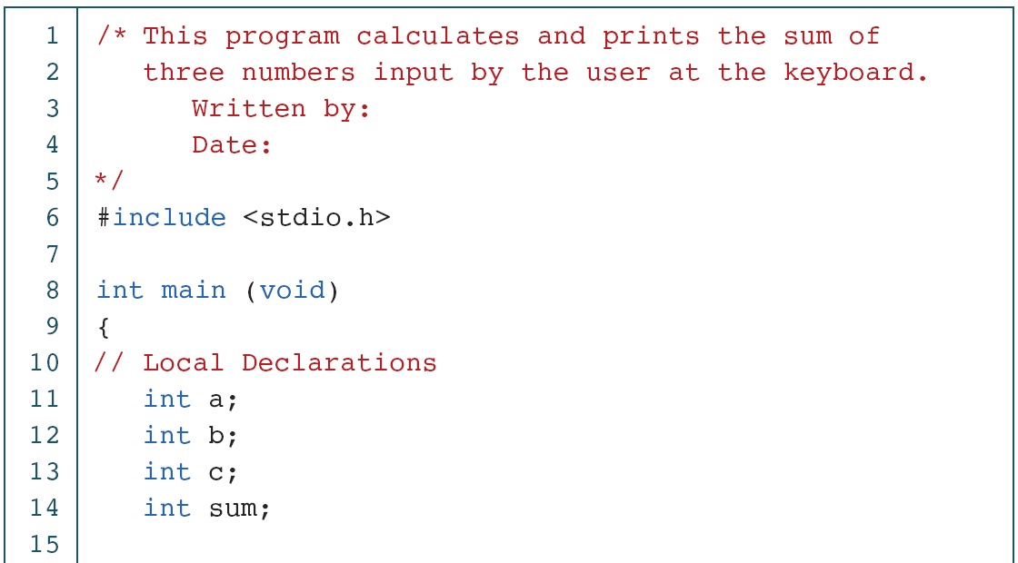
PROGRAM 2-2
Print Sum of Three Numbers

Slide 32
PROGRAM 2-2
Print Sum of Three Numbers (continued)

Slide 33
PROGRAM 2-2
Print Sum of Three Numbers (continued)

Slide 34
2-6 Constants
Constants are data values that cannot be changed during the execution of a program. Like variables, constants have a type. In this section, we discuss Boolean, character, integer, real, complex, and string constants.
Topics discussed in this section:
Constant Representation
Coding Constants

Slide 35
Note
A character constant is enclosed in single quotes.

Slide 36
Table 2-6
Symbolic Names for Control Characters

Slide 37
Table 2-7
Examples of Integer Constants

Slide 38
Table 2-8
Examples of Real Constants

Slide 39
Note
The two components of a complex constant must be of the same precision, that is, if the real part is type double, then the imaginary part must also be type double.

Slide 40
Table 2-9
Examples of Complex Constants

Slide 41
FIGURE 2-13 Some Strings

Slide 42
FIGURE 2-14 Null Characters and Null Strings

Slide 43
Note
Use single quotes for character constants. Use double quotes for string constants.

Slide 44
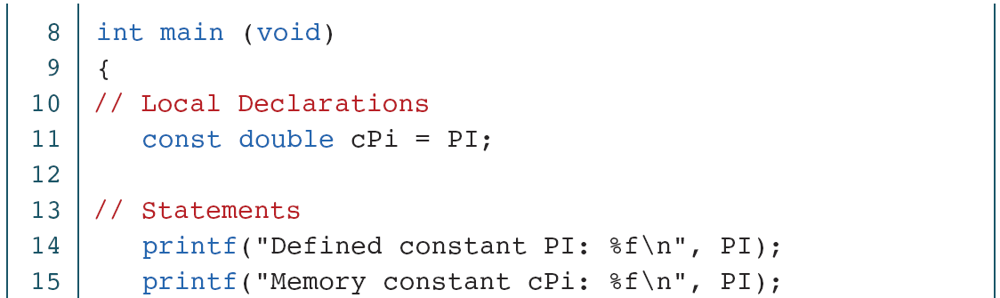
PROGRAM 2-3
Three Ways to Use Constants
c

Slide 45
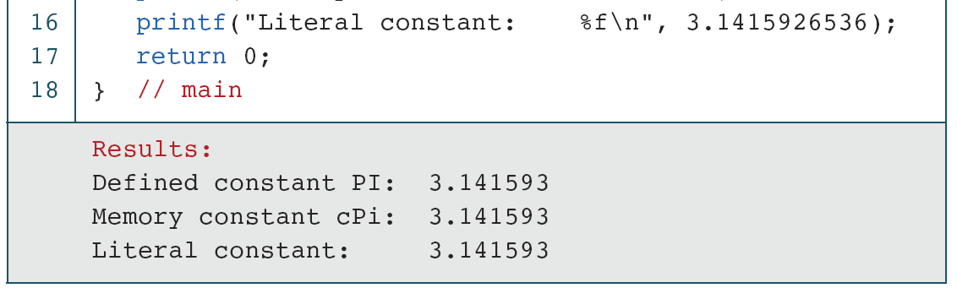
PROGRAM 2-3
Three Ways to Use Constants (continued)

Slide 46
2-7 Input/Output
Although our programs have implicitly shown how to print messages, we have not formally discussed how we use C facilities to input and output data. We devote two chapters, Chapter 7 and 13, to fully explain the C input/output facilities and how to use them. In this section, we describe simple input and output formatting.
Topics discussed in this section:
Streams
Formatting Input/Output

Slide 47
Note
A terminal keyboard and monitor can be associated only with a text stream. A keyboard is a source
for a text stream; a monitor is a destination
for a text stream.

Slide 48
FIGURE 2-15 Stream Physical Devices

Slide 49
FIGURE 2-16 Output Formatting Concept

Slide 50
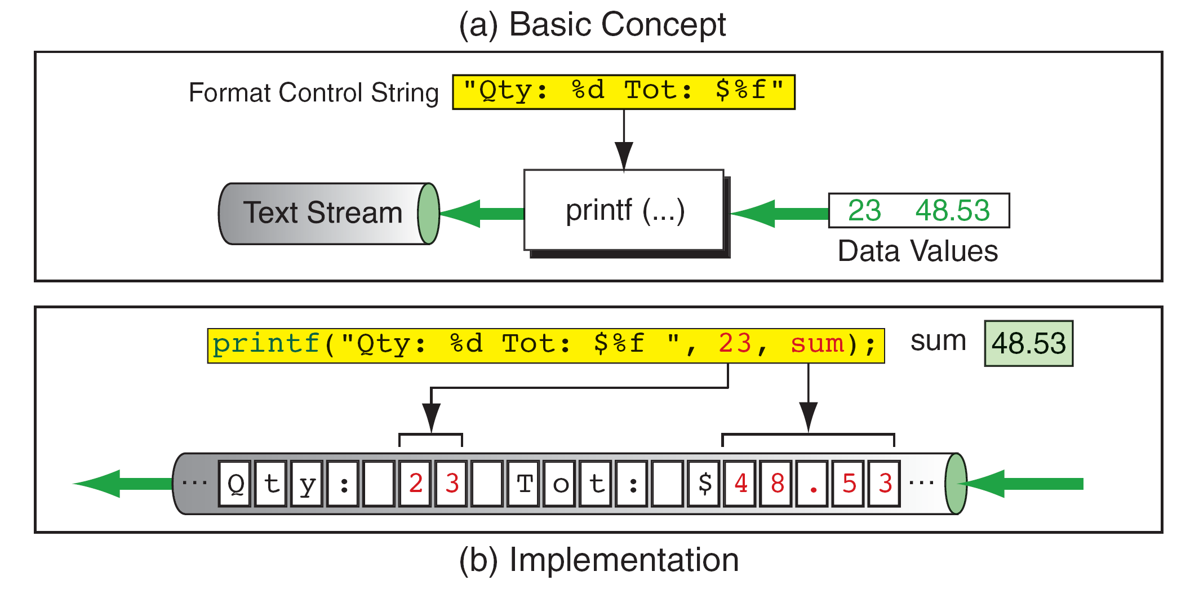
FIGURE 2-17 Output Stream Formatting Example

Slide 51
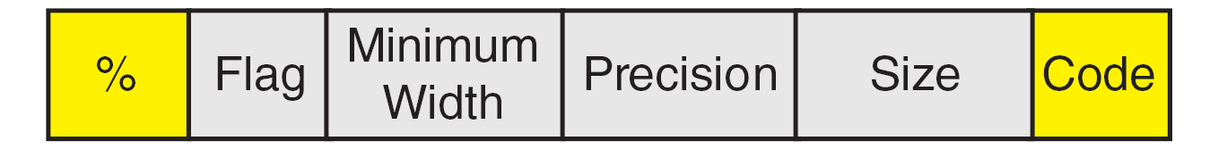
FIGURE 2-18 Conversion Specification

Slide 52
Table 2-10
Format Codes for Output

Slide 53
Space
Table 2-11
Flag Formatting Options

Slide 54
Output Examples
1. | printf("%d%c%f", 23, 'z', 4.1);
 | 23z4.100000
2. | printf("%d %c %f", 23, 'z', 4.1);
 | 23 z 4.100000
3. | int num1 = 23; char zee = 'z'; float num2 = 4.1; printf("%d %c %f", num1, zee, num2);
 | 23 z 4.100000

Slide 55
Output Examples
4. | printf("%d\t%c\t%5.1f\n", 23, 'z', 14.2); printf("%d\t%c\t%5.1f\n", 107, 'A', 53.6); printf("%d\t%c\t%5.1f\n", 1754, 'F', 122.0); printf("%d\t%c\t%5.1f\n", 3, 'P', 0.1);
 | 23 z 14.2 107 A 53.6 1754 F 122.0 3 P 0.1
5. | printf("The number%dis my favorite.", 23);
 | The number23is my favorite.
6. | printf("The number is %6d", 23);
 | The number is 23 ^^^^^^^^^^^^^^^^^^^^

Slide 56
Output Examples
7. | printf("The tax is %6.2f this year.", 233.12);
 | The tax is 233.12 this year.
8. | printf("The tax is %8.2f this year.", 233.12);
 | The tax is 233.12 this year. ^^^^^^^^^^^^^^^^^^^^^^^^^^^^^^
9. | printf("The tax is %08.2f this year.", 233.12);
 | The tax is 00233.12 this year.
10. | printf("\"%8c %d\"", 'h', 23);
 | " h 23“ ^^^^^^^^^^^^^^^

Slide 57
Output Examples
11. | printf("This line disappears.\r...A new line\n"); printf("This is the bell character \a\n"); printf("A null character\0kills the rest of the line\n"); printf("\nThis is \'it\' in single quotes\n"); printf("This is \"it\" in double quotes\n"); printf("This is \\ the escape character it self\n");
 | ...A new line This is the bell character A null character This is 'it' in single quotes This is "it" in double quotes This is \ the escape character it self

Slide 58
Output Examples
12. | printf("|%-+8.2f| |%0+8.2f| | %-0+8.2f|", 1.2, 2.3, 3.4);
 | |+1.20 | |+0002.30| | +3.40 | ^^^^^^^^^^^^^^^^^^^^^^^^^^^^^^^^^
Notes:
In the last case of example 12, the zero fill is ignored when a numeric value is printed with left justification.

Slide 59
Common Output Errors
1. | printf("%d %d %d\n", 44, 55);
 | 44 55 1638280
2. | printf("%d %d\n", 44, 55, 66);
 | 44 55
3. | float x = 123.45; printf("The data are: %d\n", x);
 | The data are: -1073741824

Slide 60
FIGURE 2-19 Formatting Text from an Input Stream

Slide 61
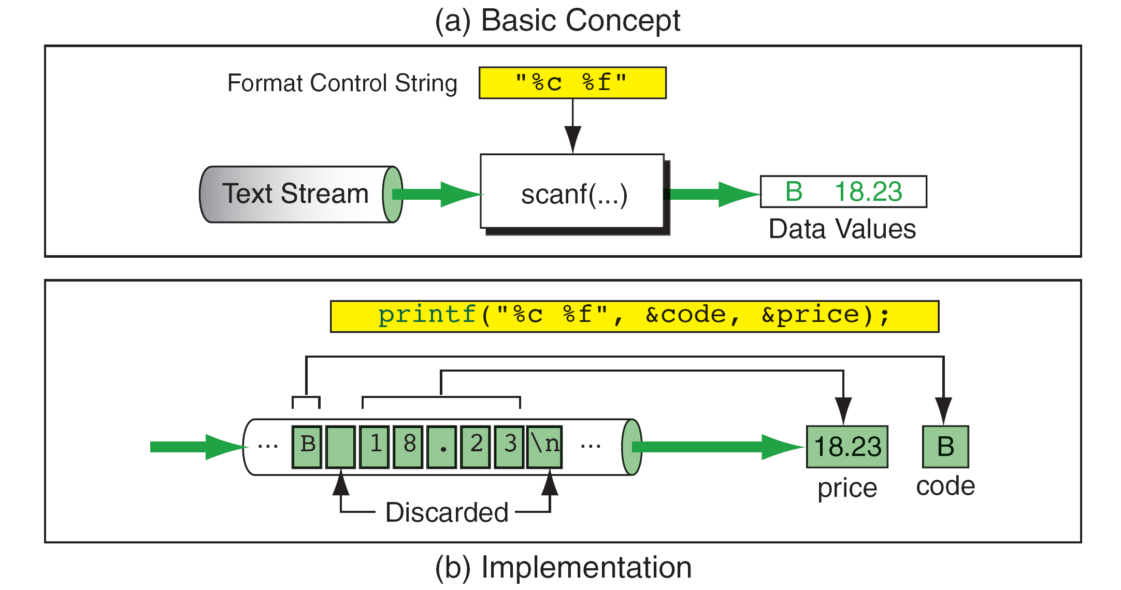
scanf(“%c %f”, &code, &price);
FIGURE 2-20 Input Stream Formatting Example

Slide 62
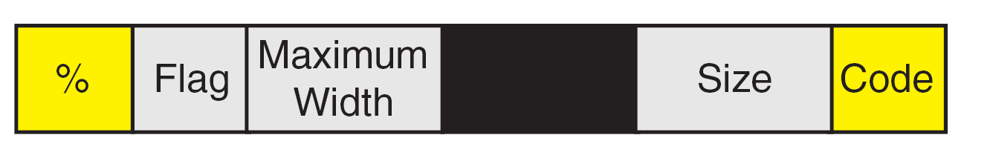
FIGURE 2-21 Conversion Specification

Slide 63
Note
scanf requires variable addresses in the address list.

Slide 64
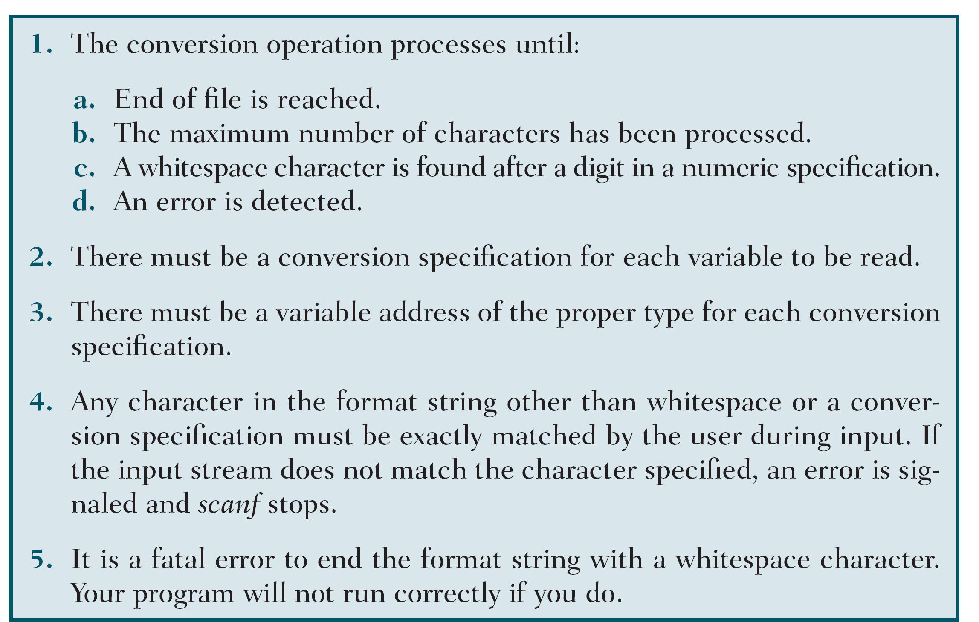
Table 2-12
scanf Rules

Slide 65
Input Examples
1-1. | 214 156 14z
 | scanf("%d%d%d%c", &a, &b, &c, &d);
1-2. | 214 156 14 z
 | scanf("%d%d%d %c", &a, &b, &c, &d);
2. | 2314 15 2.14
 | scanf("%d %d %f", &a, &b, &c);

Slide 66
Input Examples
3. | 14/26 25/66
 | scanf("%2d/%2d %2d/%2d", &num1, &den1, &num2, &den2);
4. | 11-25-56
 | scanf("%d-%d-%d", &a, &b, &c);

Slide 67
Common Input Errors
1. | int a=0; scanf ("%d", a); printf("%d\n", a);
 | 234 (Input) 0 (Output)
2. | float a = 2.1; scanf ("%5.2f", &a); printf("%5.2f", a);
 | 74.35 (Input) 2.10 (Output)

Slide 68
Common Input Errors
3. | int a; int b; scanf ("%d%d%d", &a, &b); printf("%d %d\n", a, b);
 | 5 10 (Input) 5 10 (Output)
4. | int a = 1; int b = 2; int c = 3; scanf ("%d%d", &a, &b, &c); printf("%d %d\n", a, b, c);
 | 5 10 15 (Input) 5 10 3 (Output)

Slide 69
2-8 Programming Examples
In this section, we show some programming example to emphasize the ideas and concepts we have discussed about input/output.

Slide 70
PROGRAM 2-4
A Program That Prints “Nothing!”

Slide 71
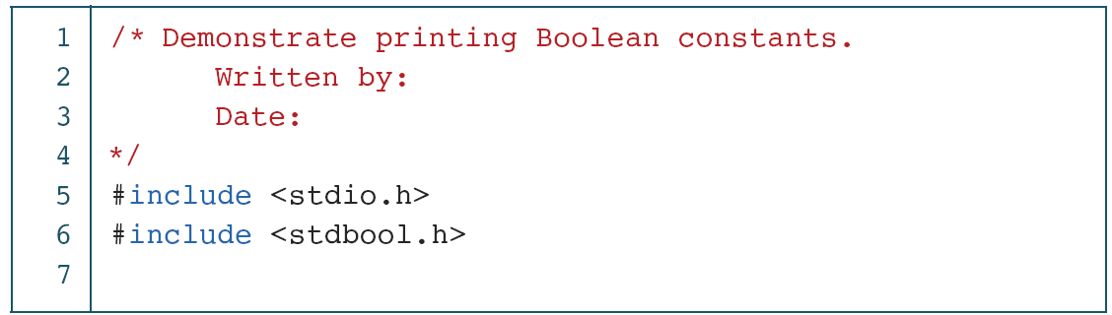
PROGRAM 2-5
Demonstrate Printing Boolean Constants

Slide 72
PROGRAM 2-5
Demonstrate Printing Boolean Constants (continued)

Slide 73
PROGRAM 2-6
Print Value of Selected Characters

Slide 74
PROGRAM 2-6
Print Value of Selected Characters (continued)

Slide 75
PROGRAM 2-6
Print Value of Selected Characters (continued)

Slide 76
PROGRAM 2-6
Print Value of Selected Characters (continued)

Slide 77
PROGRAM 2-7
Calculate a Circle’s Area and Circumference

Slide 78
PROGRAM 2-7
Calculate a Circle’s Area and Circumference (continued)

Slide 79
FIGURE 2-22 Output Specifications for Inventory Report

Slide 80
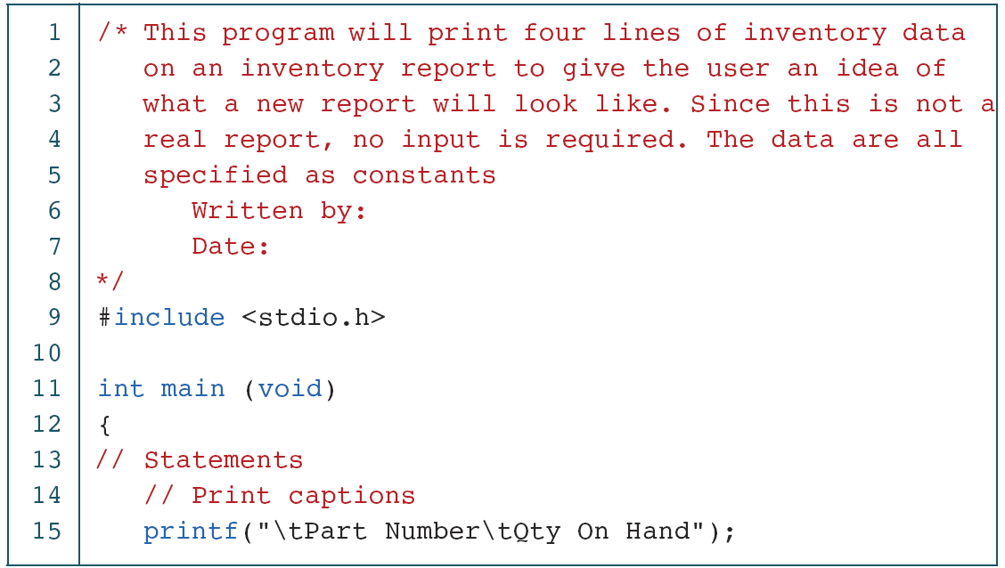
PROGRAM 2-8
A Sample Inventory Report

Slide 81
PROGRAM 2-8
A Sample Inventory Report (continued)

Slide 82
2-9 Software Engineering
Although this chapter introduces only a few programming concepts, there is still much to be said from a software engineering point of view. We will discuss the concepts of program documentation, data naming, and data hiding.
Topics discussed in this section:
Program Documentation
Data Names
Data Hiding

Slide 83
PROGRAM 2-11
Sample of General Program Documentation

Slide 84
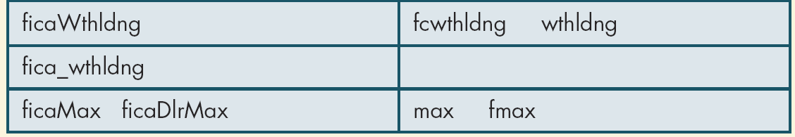
Table 2-13
Examples of Good and Poor Data Names

Slide 85
Table 2-14
Examples of Defined Constants

Slide 86
Note
Programming Standard
No variables are to be placed in the global area of a program.

